Slide 1
Testing a Ruby gem against different databases and different versions of Rails
Tony Drake
indy.rb, June 2017

Slide 2
About Me…
Rails developer for ~8 years
Enjoyer of fine Vodka
Connoisseur of Mario Kart
Gems maintained:
has_config
active_reporting
@t27duck
github.com/t27duck

Slide 3
Couple Notes
Lots of code in these slides
Move up if you want to read it!
I'll try to talk through them
Download the slides later to review if you want
Remember: "$" = Done in the terminal
Danger: There be memes ahead

Slide 4
Let's Build a Gem…
Get an array of hashes from an ActiveRecord / ActiveRelation query
Store code on Github
Use TravisCI
Test with rspec
Test with PostgreSQL
Should work with all supported versions of ActiveRecord
Should work with databases that Rails supports

Slide 5
Create the Gem
$ bundle gem raw_to_a Creating gem 'raw_to_a'... create raw_to_a/Gemfile
create raw_to_a/.gitignore
create raw_to_a/lib/raw_to_a.rb
… More files made …
create raw_to_a/.travis.yml
Initializing git repo in /directory/i/am/in/raw_to_a

Slide 6
Set Gem Dependencies (raw_to_a.gemspec)
Gem::Specification.new do |spec|
… Rest of gemspec file …
spec.add_dependency "activerecord", ">= 4.2.0" spec.add_development_dependency 'pg'
… Rest of gemspec file …
end
…. and then run "bundle"

Slide 7
Write the Gem Code (lib/raw_to_a.rb)
require 'raw_to_a/version'
require 'active_record'
module RawToA
module ActiveRecord
def raw_to_a
connection.execute(self.all.to_sql).to_a
end
end
end
ActiveRecord::Base.extend(RawToA::ActiveRecord)

Slide 8
Write Tests! (spec/spec_helper.rb)
require "bundler/setup"
require "raw_to_a"
ActiveRecord::Base.establish_connection(
adapter: 'postgresql',
database: 'raw_to_a_test',
min_messages: 'warning'
)
ActiveRecord::Schema.define do
self.verbose = false
create_table :users, force: true do |t|
t.string :username, null: false
t.boolean :active, null: false, default: true
t.timestamps
end
end
class User < ActiveRecord::Base
validates :username, presence: true
end
10.times.each_with_index do |i|
User.create!(
username: "user#{i}",
active: i % 2 == 1
)
end
RSpec.configure do |config|
... More config switches …
end

Slide 9
Write Tests! (spec/raw_to_a.spec)
require "spec_helper"
RSpec.shared_examples "#raw_to_a" do |query|
let(:subject) { query.raw_to_a }
let(:attributes) { … Snip … }
it "is an array of hashes" do
expect(subject).to be_an(Array)
subject.each do |row|
expect(row).to be_a(Hash)
end
end
… Snip …
it "has same number of elements as the query" do
expect(subject.size).to eq(query.all.size)
end
end
RSpec.describe RawToA do
… Snip ...
context "with a model class" do
include_examples "#raw_to_a", User
end
context "with an ActiveRelation" do
include_examples "#raw_to_a", User.where(active: true)
end
context "when selecting specific columns" do
include_examples "#raw_to_a", User.select(:username)
end
context "when limiting the number of rows" do
include_examples "#raw_to_a", User.limit(3)
end
end

Slide 10
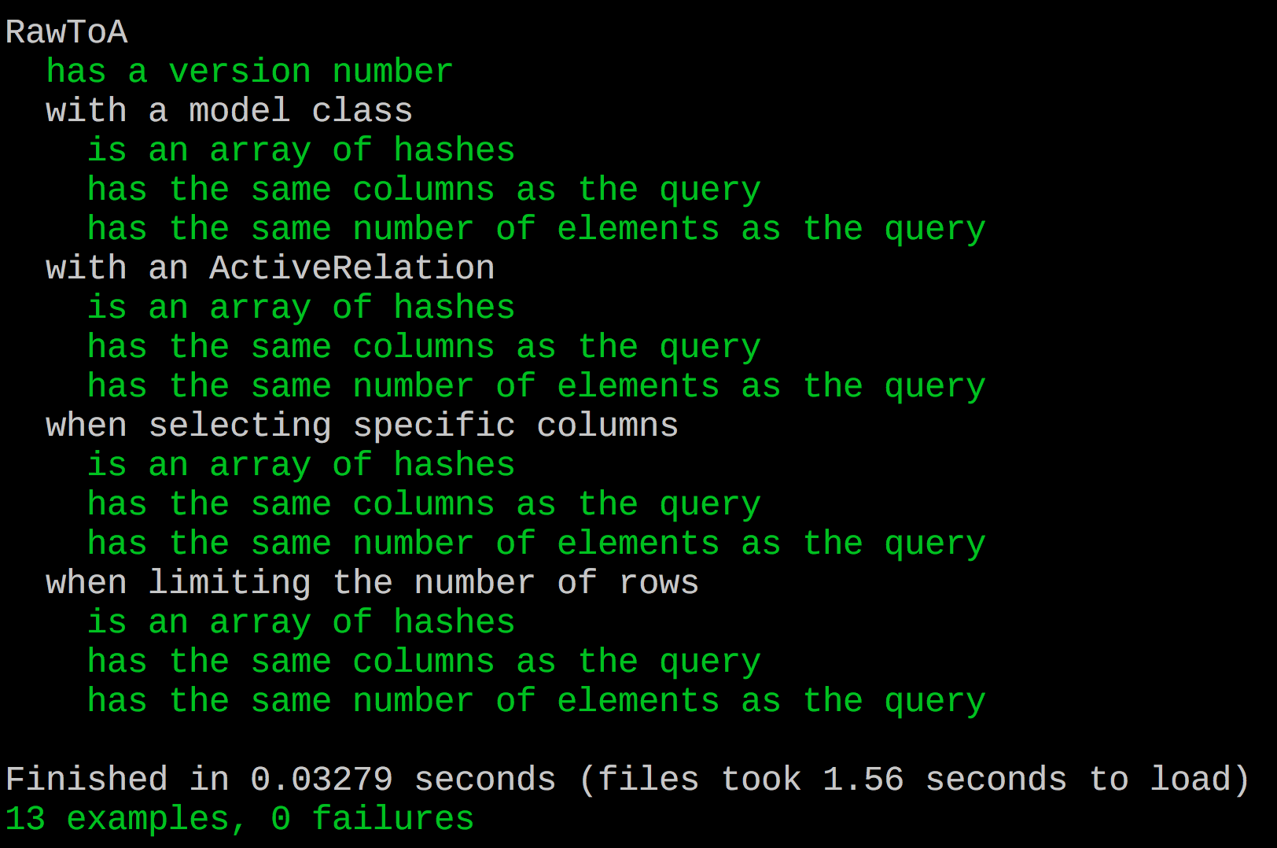
Run Tests (rake spec)

Slide 11
Set up Travis (.travis.yml)
sudo: false
language: ruby
rvm:
- 2.4.1
before_install:
- gem install bundler -v 1.14.6
- psql -c 'create database raw_to_a_test;' -U postgres

Slide 12
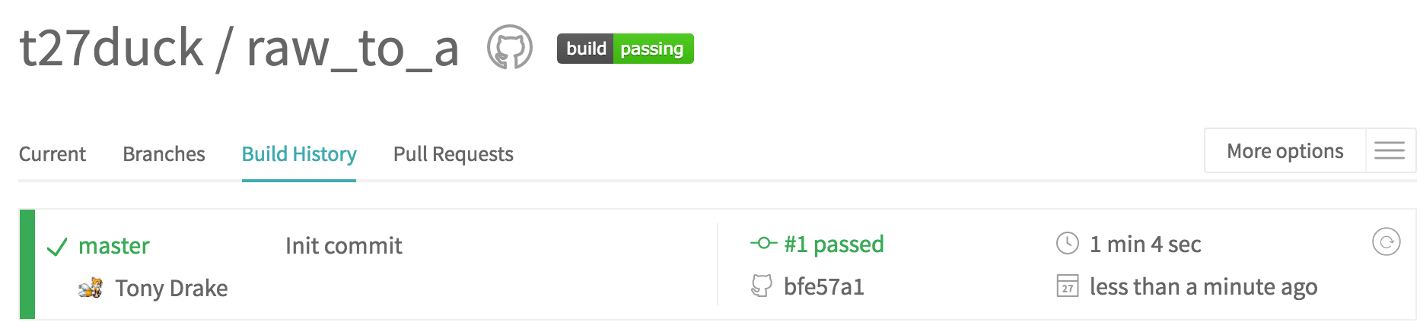
Commit, Push Up to GitHub…

Slide 13
Build Gem, Push to RubyGems.org
$ rake release
…. A git tag is made for this version ….
…. "Magic" Happens ….
"Successfully pushed to RubyGems.org"

Slide 15
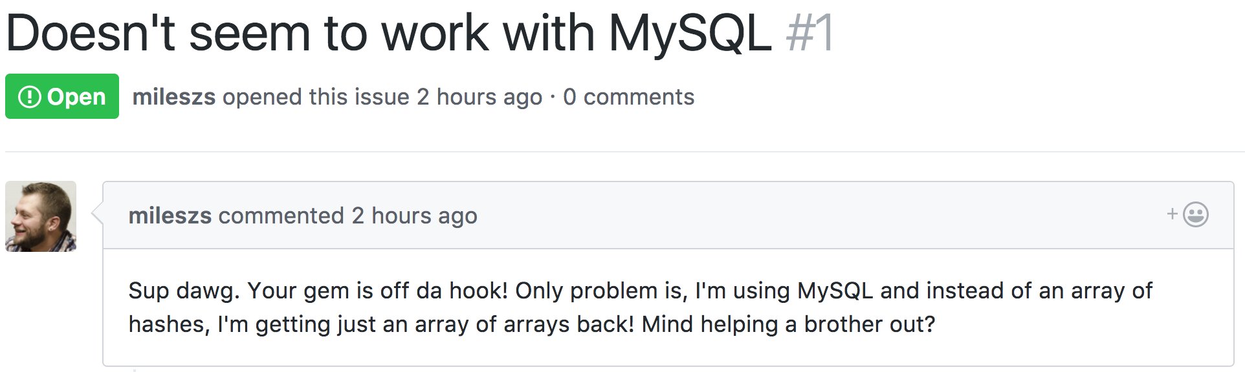

Slide 16
But…. the tests passed….

Slide 17
The Road to Reproduction (Setup)
[STEPS TO INSTALL AND CONFIGURE MYSQL LOCALLY HERE]
You're on your own for this one
Create a database called raw_to_a_test with appropriate permissions

Slide 18
The Road to Reproduction (raw_to_a.gemspec)
Gem::Specification.new do |spec|
….
spec.add_dependency "activerecord", ">= 4.2.0"
spec.add_development_dependency "pg"
spec.add_development_dependency "mysql2"
…
end
…. and then run "bundle"

Slide 19
The Road to Reproduction (spec_helper.rb)
ActiveRecord::Base.
establish_connection(
adapter: 'postgresql',
database: 'raw_to_a_test',
min_messages: 'warning'
)
ActiveRecord::Base.
establish_connection(
adapter: 'mysql2',
database: 'raw_to_a_test',
encoding: 'utf8'
)

Slide 20
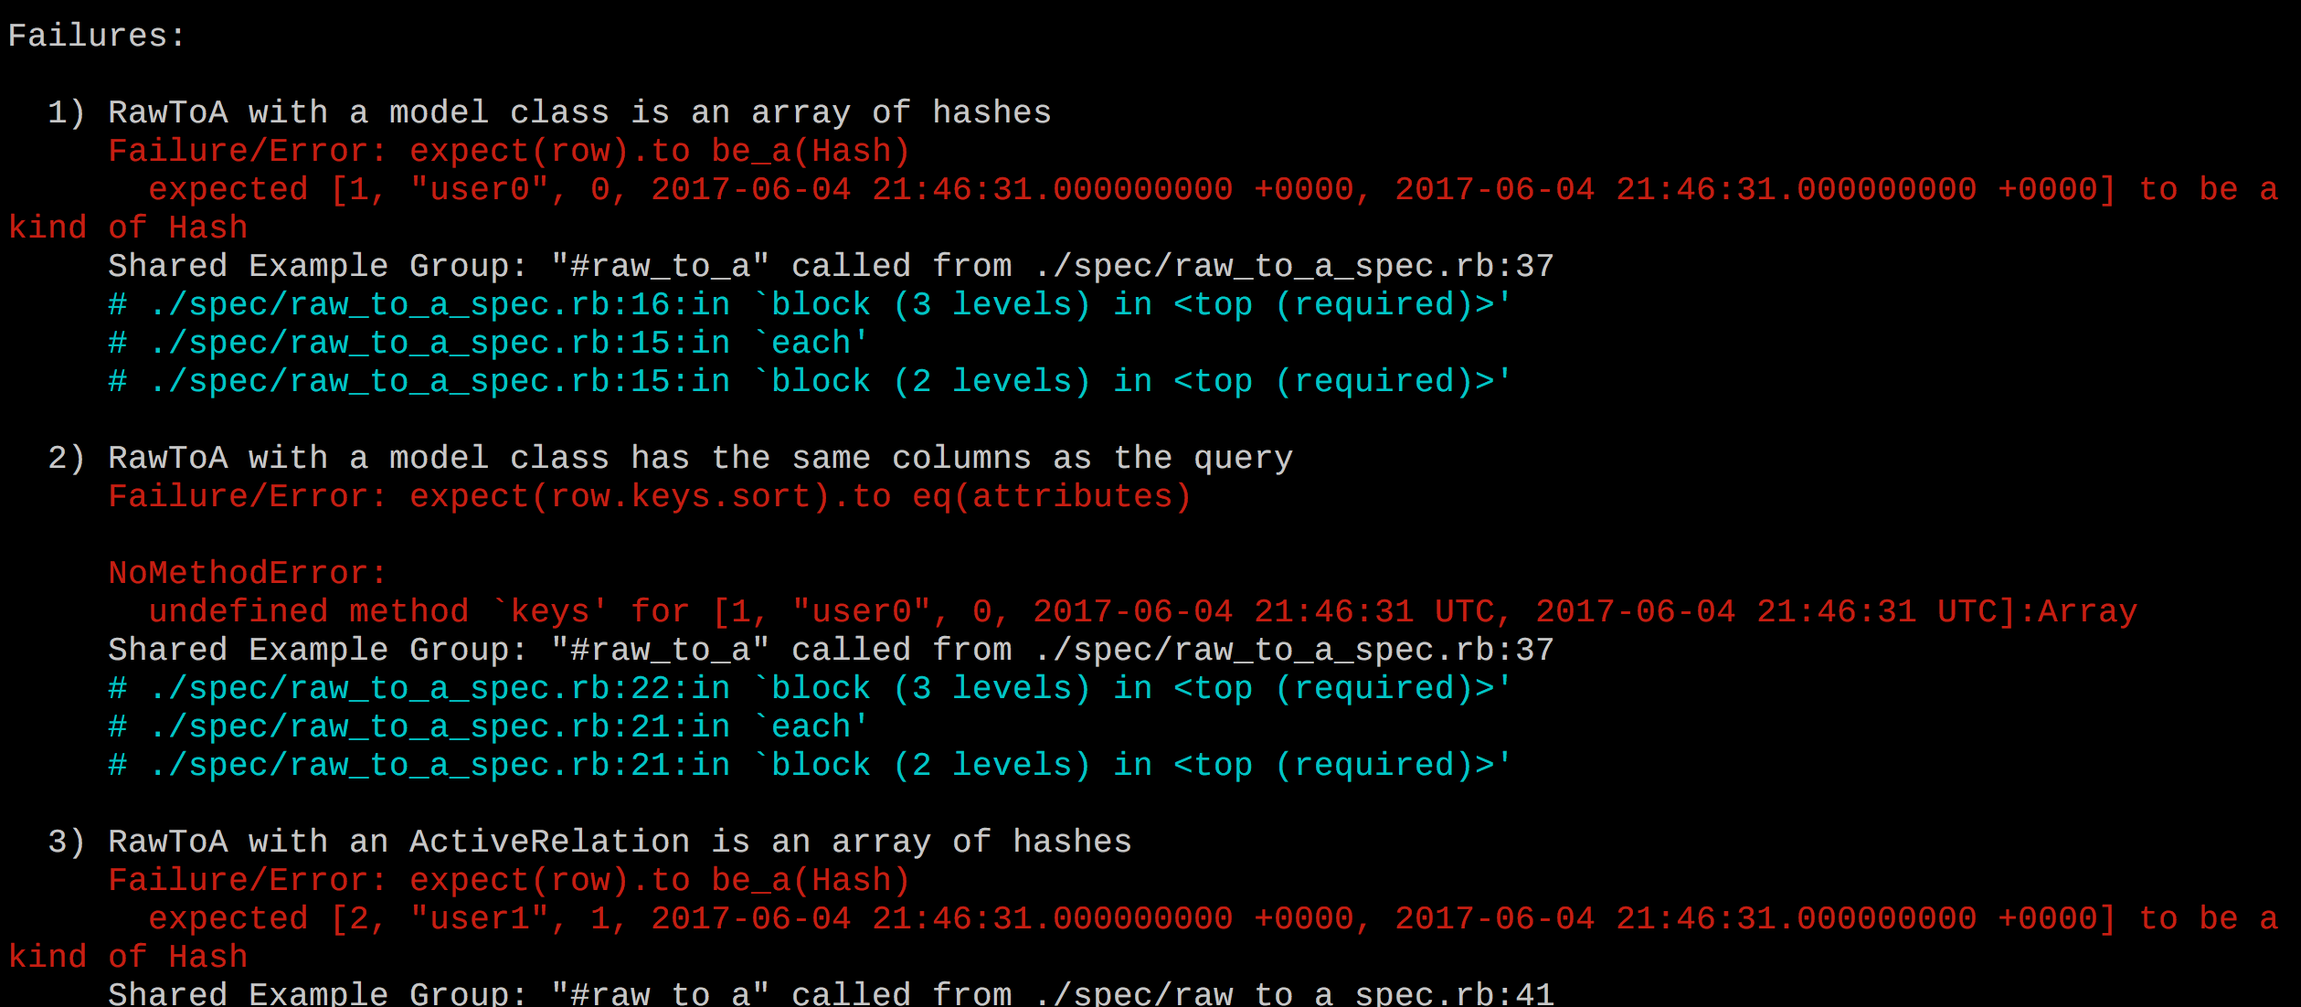
The Road to Reproduction (rake spec)
Yep, that's an array

Slide 21
Implement a fix…
require 'raw_to_a/version'
require 'active_record'
module RawToA
module ActiveRecord
def raw_to_a
connection.exec_query(self.all.to_sql).to_a
end
end
end
ActiveRecord::Base.extend(RawToA::ActiveRecord)

Slide 22
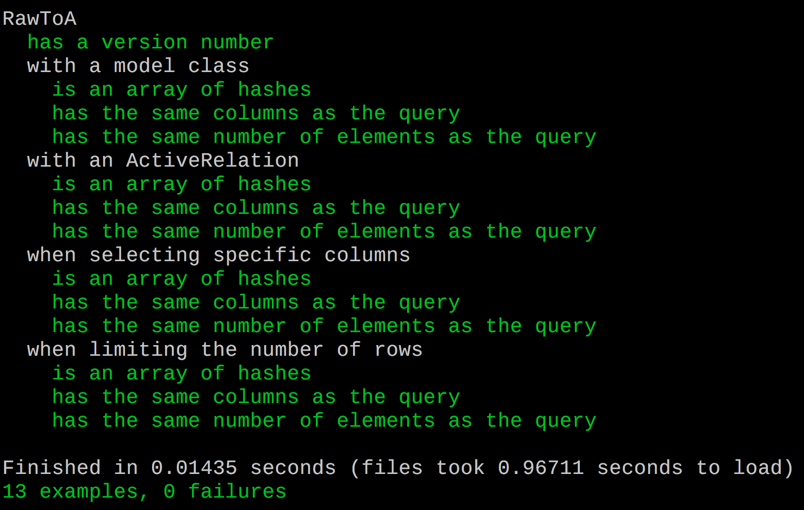
Tests work?
For sake of time:
Yes, switching the connection adaptor back to PostgreSQL and running the tests again still work.

Slide 23
Not done yet!
Can't keep manually changing the connection configuration
Is there a way to specify which database to use at runtime?
The gemspec now has both mysql and pg gems as dev dependencies
What about other versions of ActiveRecord?
What we need:
Ability to select which database driver to use and which version of ActiveRecord we want to use for tests

Slide 24
How Do We Swap out Gems?
Short Answer: On boot up
`bundle exec` locks Ruby process to the context of a Gemfile

Slide 25
What Does a Gem's Gemfile Look Like?
Gemfile
source 'https://rubygems.org'
# Specify your gem's dependencies in raw_to_a.gemspec
gemspec
raw_to_a.gemspec
spec.add_dependency "activerecord", ">= 4.2.0"
spec.add_development_dependency 'pg'
spec.add_development_dependency 'mysql2'
spec.add_development_dependency "bundler", "~> 1.14"
spec.add_development_dependency "rake", "~> 10.0"
spec.add_development_dependency "rspec", "~> 3.0"

Slide 26
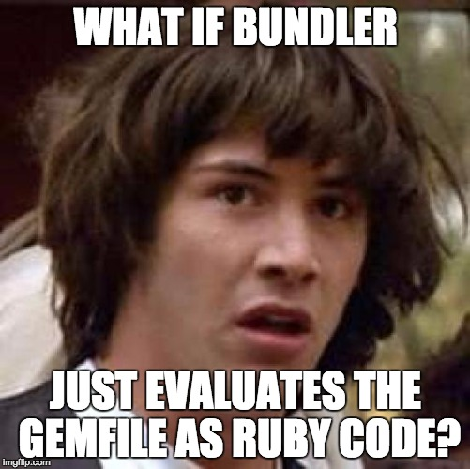
How do we get bundler to load only the gems we want?
Spoiler: That's precisely what bundler does!

Slide 27
Let's make the Gemfile "smarter"
source 'https://rubygems.org'
gemspec
case ENV['AR'] || '4-2'
when '5-0' then gem('activerecord', '~> 5.0.0')
when '5-1' then gem('activerecord', '~> 5.1.0')
else gem('activerecord', '~> 4.2.0')
end
case ENV['DB'] || 'pg'
when 'mysql' then gem('mysql2')
else gem('pg')
end
Also:
Remove the gems as dev dependencies in the gemspec
Install/Update With:
$ bundle update
$ DB=mysql bundle update
$ AR=5-0 DB=mysql bundle update

Slide 28
Let's make the spec helper "smarter"
db = ENV['DB'] || 'pg'
ar = ENV['AR'] || '4-2'
puts "TESTING WITH: ActiveRecord: #{ar} | Database: #{db}"
case db
when 'mysql'
ActiveRecord::Base.establish_connection(
adapter: 'mysql2', ….
)
else
ActiveRecord::Base.establish_connection(
adapter: 'postgresql', ….
)
end

Slide 29
How to run our tests locally
Command | ActiveRecord | Database
$ bundle exec rake spec | 4.2 | PostgreSQL
$ AR=5-0 bundle exec rake spec | 5.0 | PostgreSQL
$ DB=mysql bundle exec rake spec | 4.2 | MySQL
$ AR=5-1 DB=mysql bundle exec rake spec | 5.1 | MySQL
$ AR=5-0 DB=pg bundle exec rake spec | 5.0 | PostgreSQL
"bundle exec" is required to force specific gems to load
"bundle update" (with the environment variables set) may be be required between each run of the tests

Slide 30
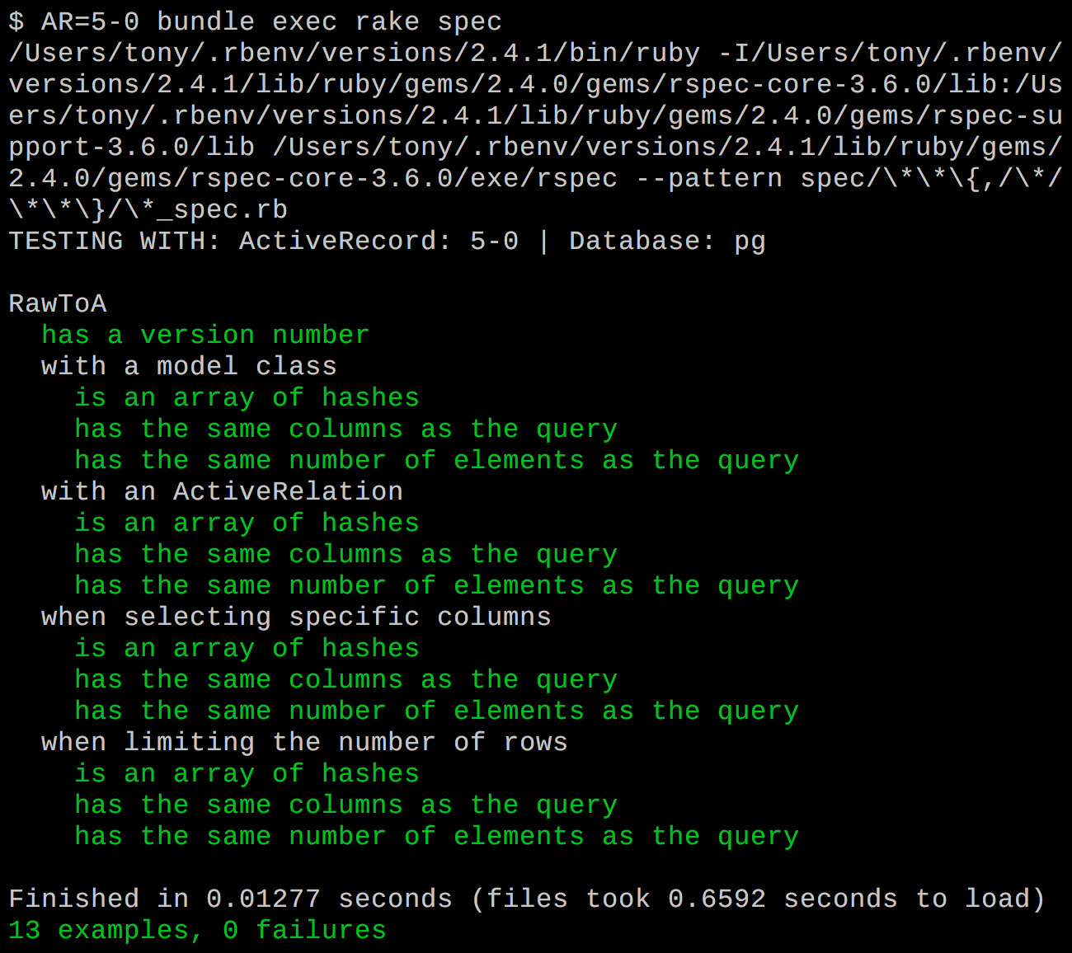
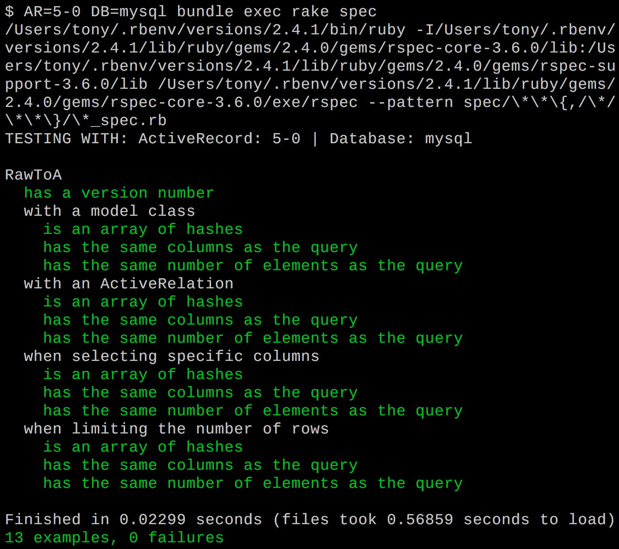
How to run our tests locally

Slide 31
Can we get CI to run all the things? (.travis.yml)
sudo: false
language: ruby
rvm:
- 2.2.7
- 2.3.4
- 2.4.1
env:
- AR=5-1 DB=pg
- AR=5-1 DB=mysql
- AR=5-0 DB=pg
- AR=5-0 DB=mysql
- AR=4-2 DB=pg
- AR=4-2 DB=mysql
before_script:
- psql -c 'create database raw_to_a_test;' -U postgres
- mysql -e 'create database raw_to_a_test collate utf8_general_ci;'

Slide 32
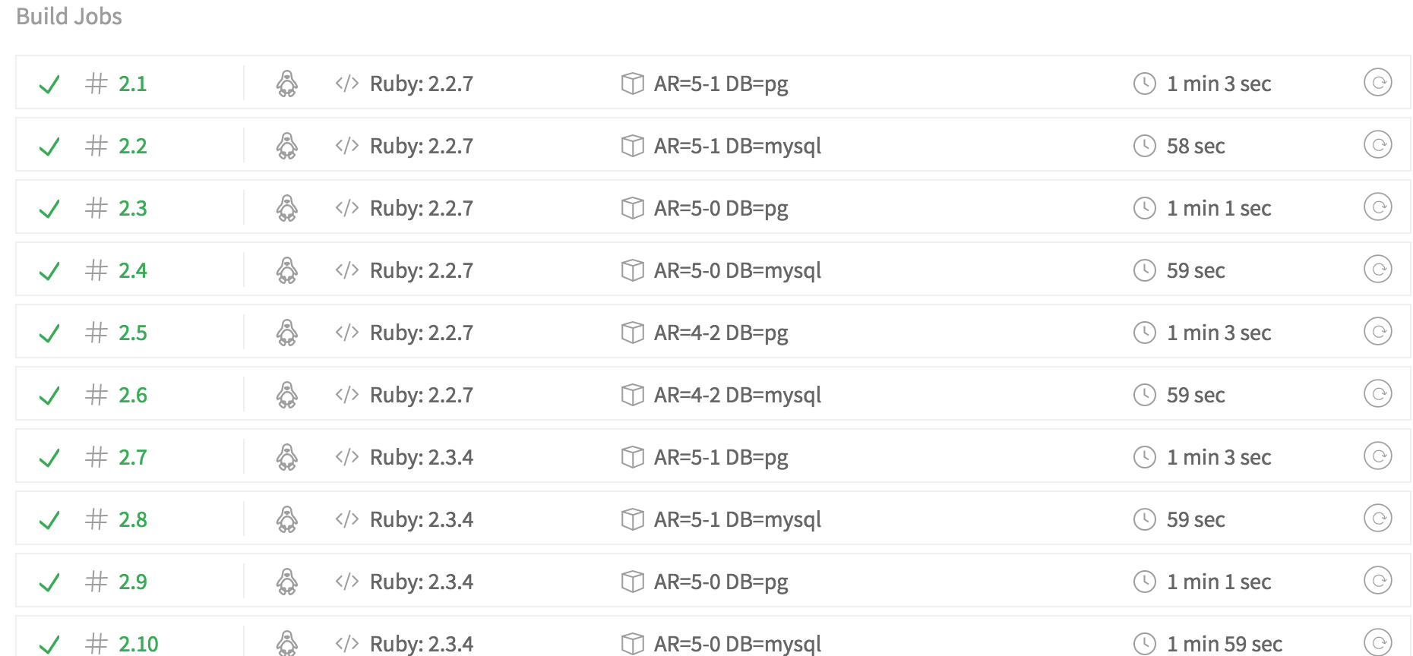
Can we get CI to run all the things? (.travis.yml)

Slide 33
Finish it up…
Bump the version number
Write a changelog (maybe?)
Commit and push…
$ rake release
Close the issue
Celebrate

Slide 34
Alternative Options
Gemfile for each permutation of ActiveRecord / DB combo
Set BUNDLE_GEMFILE environment variable
Natively supported by TravisCI

Slide 35
The End
Slides: https://github.com/t27duck/showandtell
The actual gem: https://github.com/t27duck/raw_to_a
"Find me" at: @t27duck
Memes powered by:
imgflip.com
memecrunch.com
memegenerator.net
Support rubygems.org and bundler!

